Slide 1

Capstone Project – Detailed Report
Coursera – IBM Certificate in Data Science Project Submission v
July 2020

Slide 2
1. Introduction
The IBM Certificate in Data Science course on Coursera culminates in a Capstone Project, which has a defined outline to the requirements for qualifying and passing the final course assessment.
The parameters of the Capstone project guide that users should apply the knowledge obtained during the course to a real life business opportunity that would benefit from the techniques found in the course. Specifically for this one, the requirement is to apply the K-Clustering approach to the defined business opportunity.
The other key parameter is that the submission must use the FourSquare API to obtain venue data, which is to be used in the analysis.
This presentation and its accompanying Jupyter notebook (which can be found at the link below) outline such a business opportunity and the associated analysis to address this need.

Slide 3
2. The Business Opportunity
This business issue is a hypothetical one as I don't have a real case that fulfils the requirements for the Capstone Project i.e. use FourSquare API and data. This case involves a business with investments in the Food & Beverage / Hospitality sector looking to expand into the Richmond-upon-Thames administration area. The Richmond-upon-Thames administration area lies within the boundaries of the Greater London are and consists of 19 main neighbourhoods. This includes famous landmarks such as the Twickenham Rugby Stadium, which is considered the home of rubgy
The business is looking to enter this area by opening another outlet. The business runs multiple arms in the business, which includes coffee shops, fast food joints, restaurants and wine bars. As a first step in opening an outlet, the business would like to get an initial understanding of the neighbourhoods and the clustering of food related companies operating in these regions. This will then feed into further analysis necessary for decision making including socio-economic distributions, footfall patterns, food venues opening/closing data, market gaps.
Assumptions, business logic: The assumption behind the analysis is that we can use unsupervised machine learning to create clusters of neighbourhoods that will provide us a list of areas for consideration for the restaurant. The intent is the opening will be ideally located in a potentially underserved neighbourhood or one with a gap in offerings (e.g. lack of a high-end burger place).
This notebook addresses this first step in the analysis.

Slide 4
3. The Data, Scope, Approach, Assumptions and Limitations
The following are the key data sources to be used.
List of the neighbourhoods in the Richmond admin area -> This will be scraped from the website www.doogal.co.uk .. This provides some key location information. I have used the Postcode, Ward (which I have renamed to Neighborhood), Latitude and Longitude
Top venues of neighbourhoods -> Foursquare API is used to collect the venue data such as Name, Category, geographic location details such as Latitude and Longitude
Co-ordinate data is inherent in the data coming from www.doogal.co.uk
Scope, Approach, Assumptions and Limitations
Scope- we will work through all 19 neighbourhoods of the admin area. In doing this, though there is postcode data that provides greater granularity, for brevity and focus, we will look at the neighbourhood names and group all the subsequent processing on this attribute. Therefore analysis is performed at the neighbourhood level.
Approach: After tidying up the data, we will apply K-means machine learning technique for creating clusters of the neighbourhoods. We will use silhouette score for choosing the optimal number of clusters.
Assumption: The data obtained from both data sources is considered complete and accurate. No separate verification process has been performed.
Limitations: Due to multiple considerations, the data gathering from the FourSquare API is limited to 500m around the co-ordinates being used for each of the neighbourhoods. An initial limitation on the venues retrieved was set to 50. However, the results returned were limited so it was decided to increase this number to 100.

Slide 5
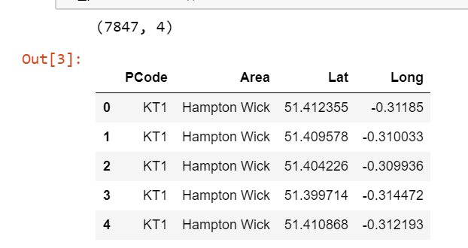
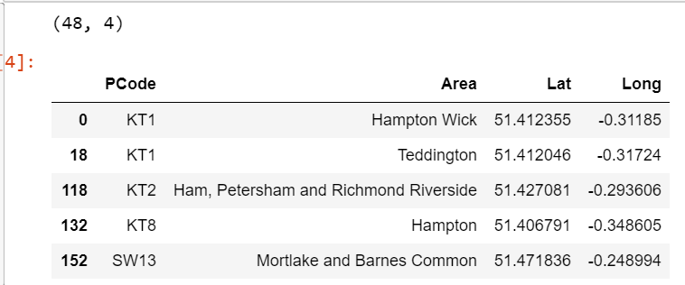
4. The Analysis
1.1. Data Cleansing
As a first step, the data was scraped from the website (www.doogal.co.uk) and examined. This highlighted duplications of the neighbourhoods based primarily on the postcodes. For the purposes of this assessment, this would introduce a very large set of datasets to assess. So I made a decision to limit the number of neighbourhoods on the names rather than unique postcodes. This produced the following results:-
The box on the left shows the Shape of the data before cleaning, whilst the box on the right shows the resultant cleaned data frame.
NB. In a real life business case, I would have chosen a different approach in streamlining this data without losing the granularity that is offered by the initial dataset. However, this approach would be governed by the business needs.

Slide 6
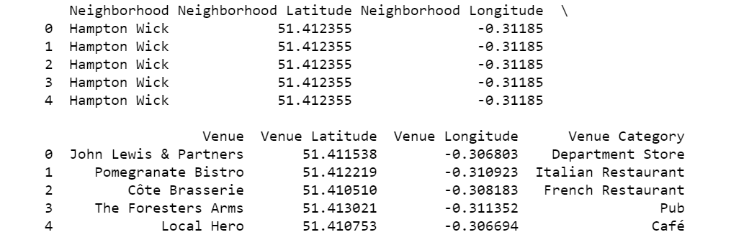
4. Analysis (Cont’d)
1.2 Obtaining Venue Information from FourSquare
The next step after the data cleansing is to obtain venue information from the FourSquare API. In this step, we use the selected neighbourhoods and use their geographic information (latitude and longitude) to base as the centre of the query whilst limiting the search to 500m around this point. We capture 100 venues at the maximum.
The above table shows the first 5 rows of the resultant data frame that contains the neighbourhood details and the venue details (name, category, latitude, longitude). This will be used for the next stages of the analysis.

Slide 7
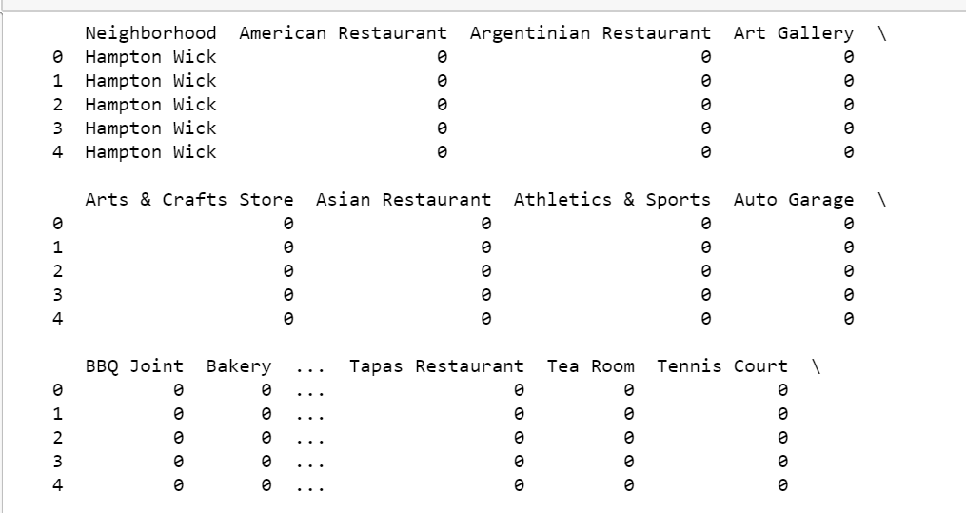
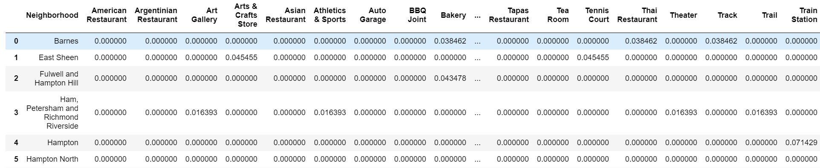
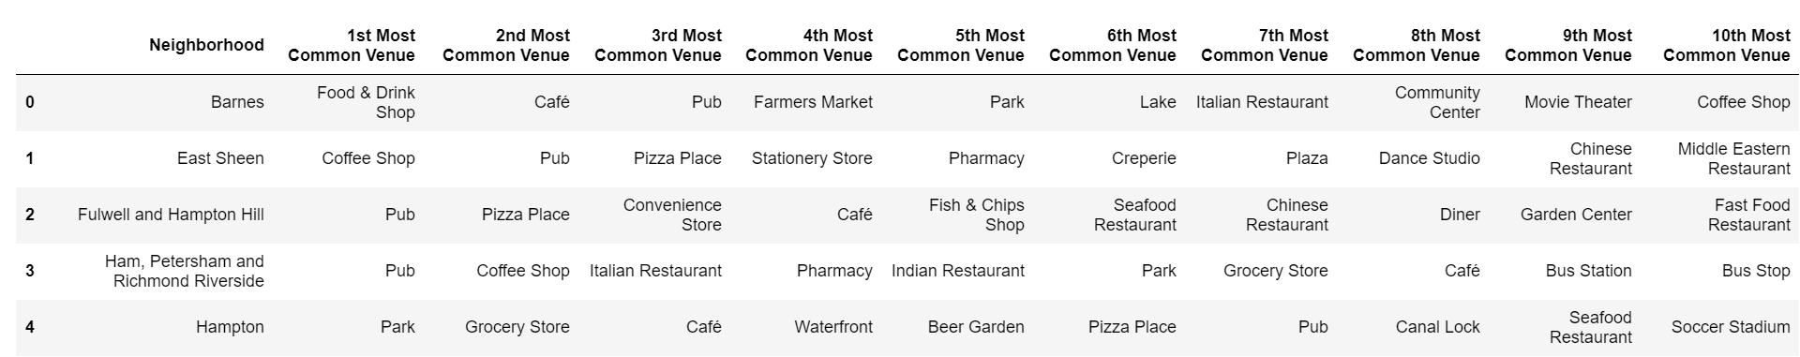
4. Analysis (Cont’d)
1.3 Prepare the Data for K-Clustering.
The first stage in this process is to perform the One-Hot encoding. The picture below shows samples of the output from this stage.
The data frame is now ready for the clustering analysis. However, before we do the clustering, we will run the Silhouette Scoring algorithms to identify the optimal cluster size.

Slide 8
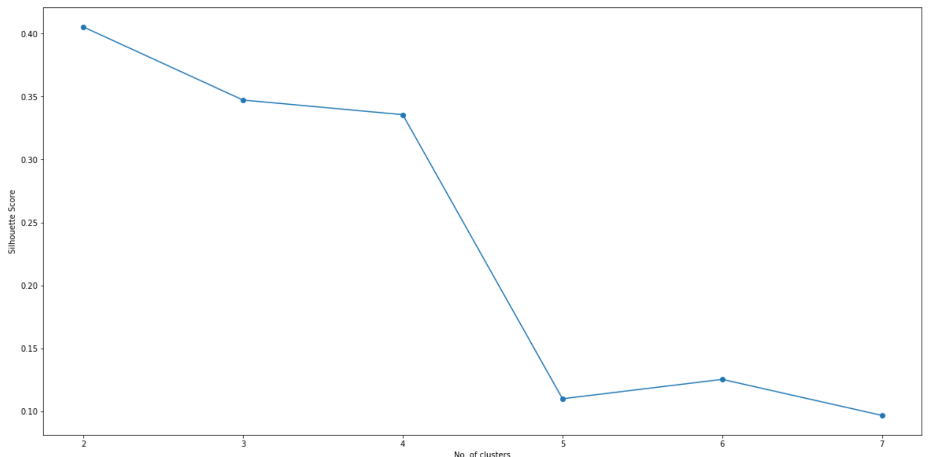
4. Analysis (Cont’d)
1.4 Silhouette Scoring
The second stage is to run the Silhouette Scoring on the data to understand and confirm the ideal cluster size. The following is the resultant output from this step.
This shows that the optimal cluster size would be 5. This is what will be used to complete the analysis .
Optimal Cluster Size

Slide 9
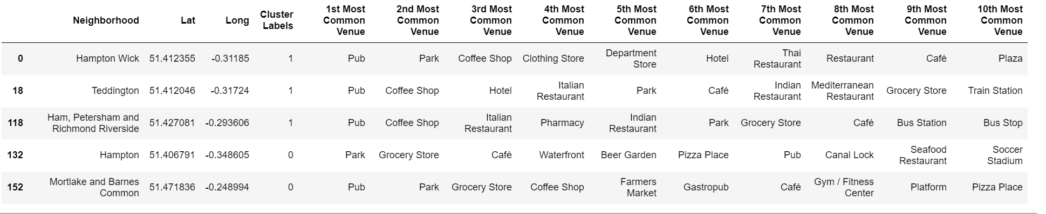
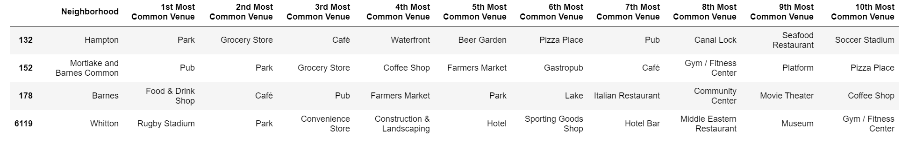
4. Analysis (Cont’d)
1.5 Clustering and Analysing Output.
After running the clustering algorithms the following table shows the final data frame which I will be analysing.
I now start looking at each cluster starting with Cluster 1

Slide 10
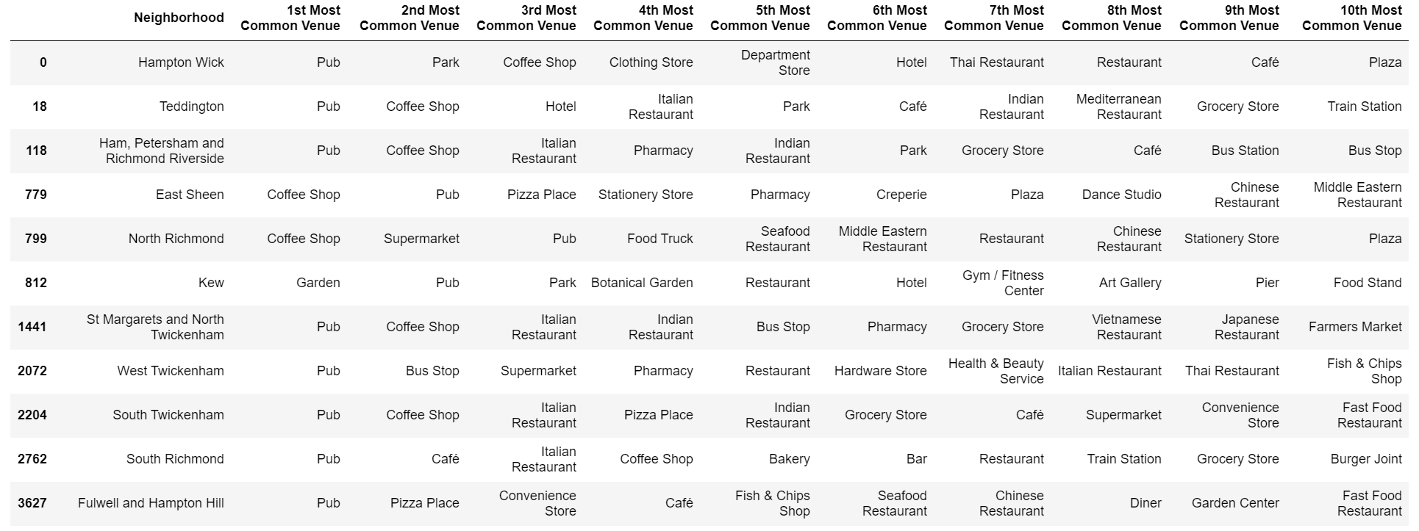
4. Analysis (Cont’d)
Cluster 2

Slide 11
4. Analysis (Cont’d)
Cluster 3
Cluster 4
Cluster 4

Slide 12
5. Conclusion
At the onset, the question that was framed was to identify some neighbourhoods for further investigation and research. The analysis will further be developed on two branches.
Branch 1 - Underserved Locations. This branch will look at neighbourhoods that, based on this analysis, appear to be underserved by a variety of food outlets be these coffee shops or proper restaurants. In this category, the business may look at the neighbourhoods in Cluster 1 or Cluster 3. To elaborate with examples:-
In Cluster 1, Whitton looks promising. It has a nearby Rugby stadium, a park, a hotel and a museum which suggests footfall. Yet it only has 1 restaurant. This presents an underserved area.
In Cluste3 , Heathfield has a similar scenario as above. There is a cricket ground, a soccer field, a park, some stores but only 1 food establishment in the 10 ten. There seems to be footfall albeit it could be time-based (busy on weekends etc)
Branch 2 – Gap in the Market. Cluster 2 offers the best options for further investigations. A lot of the neighbourhoods in this already have pubs as the most popular venues along with various types of restaurants. A casual scan suggests a concentration of Italian and Asian restaurants along with some fast food places. Is there a gap in the market for say something like a South American (say Mexican) ? Or even further analysis of the Asian restaurants suggests a gap for a Japanese (sushi or izakaya) establishment. Perhaps somewhere like Fulwell and Hampton Hill or North Richmond .
Of course, further investigation and analysis is need to progress this into a real business plan but this starts off this by helping the business focus within certain neighbourhoods.

